Slide 1
Notes to the Presenter
Slides 2-10 contain notes for the presenter and are hidden.
You may include your picture and company logo on the intro slide only
It is appropriate to provide a brief background (1 minute or less) on your organization.

Slide 2
Presentation Best Practices
Frame your presentation by answering:
What do you want your audience to learn?
What do you want your audience to do differently?
What result or outcomes do you want your audience to realize?
Clarify your session objectives at the beginning of your presentation.

Slide 3
Presentation Best Practices
Pictures speak 1,000 words; include a screenshot or picture on each slide to add visual interest.
A good goal is to aim for 7 words per slide.
Increase attention and interaction by using a variety of communication mediums, such as polls and videos.
Plan and follow a rough agenda including a breakdown by minute to help stay on track.

Slide 4
Example of Text Layout
Main topic 1: size 28pt
Size 24pt for the subtopics
Size 24pt for the subtopics
Main topic 2: size 28pt
Size 24pt for the subtopics
Size 24pt for the subtopics
Main topic 3: size 28pt
Size 24pt for the subtopics
Size 24pt for the subtopics

Slide 5
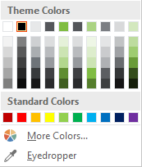
Slide Palette Info
The PowerPoint palette for this template has been built for you and is shown below. Avoid using too many colors in your presentation.
Select the 4th color from the left for subheads and 1st level non-bulleted text color, or wherever “color” text is preferred over the default black/white text
Accent colors 1-6 – (6 Theme Colors to the far right)
Text
Dark 2
Accent 1
Accent 2
Accent 3
Accent 4
Accent 5
Accent 6
Use Accent 1 as the main accent color. Use Accent 2 and Accent 3 when additional colors are needed.
Use Accents 4-6 sparingly – only when more colors are necessary.

Slide 6
Chart Example

Slide 7
Lots of data? Minimalize and Plan
Gray is used to de-emphasize data that is less important. Use cool gray 3 or cool gray 7. See slide 7 for color formulas.
All elements have the same interior margins as text blocks.
When a chart or graphic, has more elements than can easily be aligned to the grid, align the outer edges of the group, top, bottom, left and right edges to the grid.
It is preferable to keep the group aligned to the left border.
130M
140M
125M
Other
Other
Other
Other
Other
Other

Slide 8
Chart Example

Slide 9
Notes (hidden)
Some speakers like to use this slide for hidden “notes slides”.
Delete it if you don’t want to use it.

Slide 10
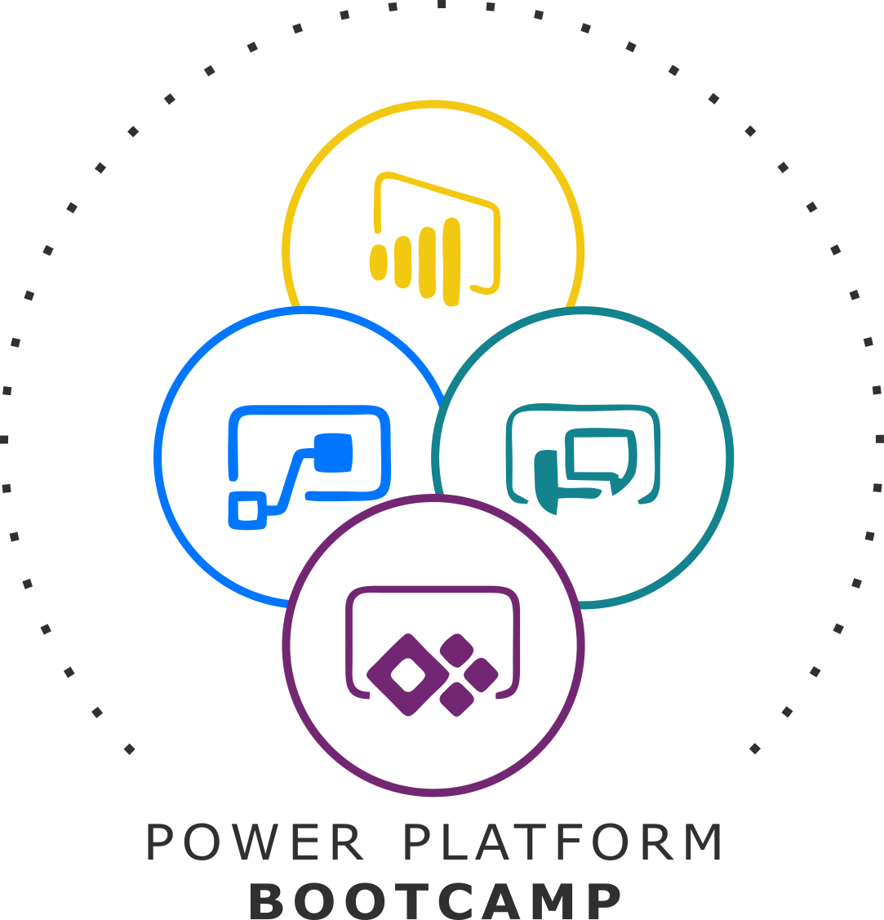


GLOBAL POWER PLATFORM BOOTCAMP
Organized Globally, Held Locally

Slide 11
Keynote
Sunny Rajpal

Slide 12

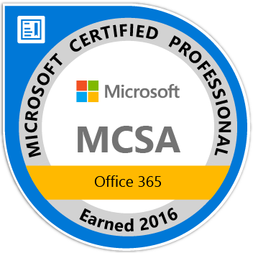



Sunny Rajpal
Microsoft certified professional
Leading Content Services / ECM practice within Nagarro Software Pvt. Ltd
SharePoint, O365, Power Platform & different ECM tools(Sitecore, Liferay, Documentum etc.) solution architect
15+ year of experience and working with Nagarro since 2009
@sunnynagarro
https://www.linkedin.com/in/sunnyrajpal/

Slide 13
Application Platform as a Service (aPaaS)
Sunny Rajpal

Slide 14
Session Agenda
Power Platform Strategy
Customer Experience and Innovation for Everyone
Digital transformation stories from Power Platform customers

Slide 15
Power Platform Strategy

Slide 16
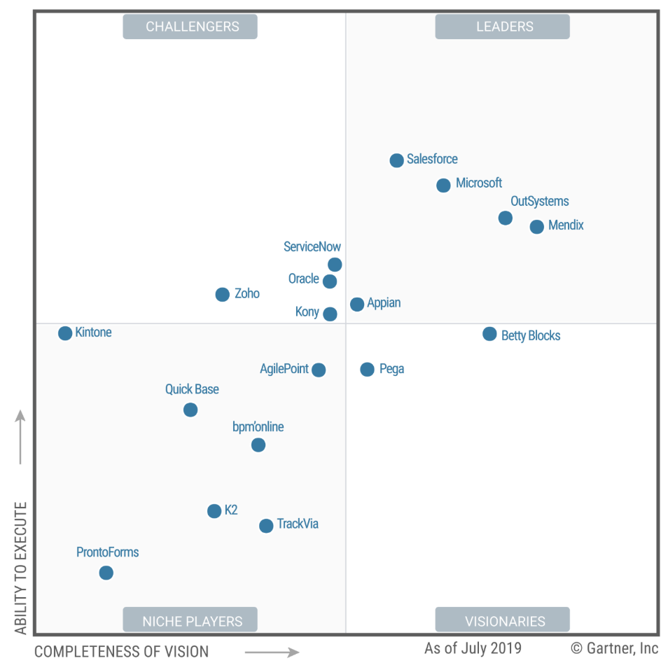
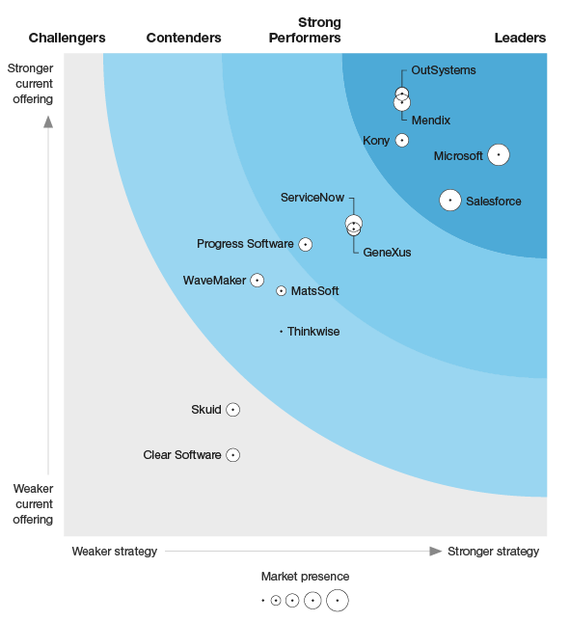
Low code solutions
Challenges
Introducing LCAP with AI
The Forrester Wave
Budget
constraints
Time & Resource
constraints
Business
expectations
IT/Business
partnership
Legacy system
maintenance
Disparate Business Systems
Gartner’s Magic Quadrant
Leverage existing
technology
Security &
Compliance
Critical Functions
Notes:
Microsoft leaps to the top tier, but its product lineup may confuse. Microsoft has fully delivered its PowerApps platform after years of unfurling. In our last assessment (2016 to 2017), PowerApps was too limited for AD&D pros but good for business developers. PowerApps is now a leading choice among low-code platforms for AD&D pros, although reference customers suggest it isn't yet widely used at enterprise scale. The platform offers powerful features for developing web and mobile user experiences, a big catalog of integration adapters, and affinity to Excel in its scripting tool that business developers will appreciate.

Slide 17

Power Platform
Application Platform as a Service
Easily build apps with low code/no code platform
6. Integration and Connectors
1. Power Apps
Support for more than 300 connectors
Prebuilt and custom connectors
70% reduction in app development cost
15% improvement in business process
Automate workflows and model business processes
Get insights for your data using Power BI
5. Inbuilt AI support
AI support within PowerApps and Power Automate
Prebuilt AI models
2. Power Automate
Power BI
Process Automation
Point and click workflow designer
Supports more than 200 sources
Connect data with 230+ pre-built connectors and custom connectors
4. Common Data Service (CDS)
Strong enterprise governance & security
3. Power BI
Rich security model
Supports server-side logic and validation to ensure data quality
Fastest growing BI
12 consecutive years, Garter named it as a leader
DLP capabilities to protect data
Pro-dev extensibility with Azure and custom logic

Slide 18

Power Platform momentum
>700%
>300%
>3M
growth in PowerApps production apps in the last year
growth in PowerApps Monthly Active Users in the last year
Monthly Active Developers on the Power Platform
97%
>20PB
>25M
>25B
Of all Fortune 500 companies using Power Platform
Of data ingested into Power BI each month
Data models hosted in the power BI service
Microsoft Flow steps run each day
Credit: Microsoft

Slide 19
Customer experience and Innovation for everyone

Slide 20
Why Customers use Power Platform
Stunning visuals
Automated workflows
Build apps quickly
Full Microsoft Stack
One connected platform
Notes:
Christoph

Slide 21




Innovation for everyone
For Business Users
For IT
For Citizen Developers
For Developers
Real time data
Automate tasks
Optimize user adoption with app
Secure BI for organization
Connect to on-premise and cloud-based data
Office 365 Admin Portal
Prep data with ease
Connect to hundreds of sources
Perform tasks with minimal clicks
Single view across ecosystem
Decision-based workflows
Embed PowerApps into other solutions

Slide 22
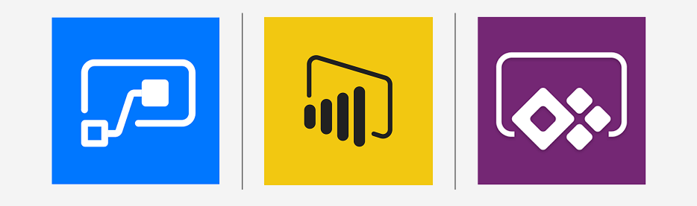
PowerApps
Power Automate
Power BI

Slide 23



Act. Analyze. Automate.
Power BI
Business Analytics
PowerApps
Application Development
Power Automate
Workflow Automation
Power Virtual Agent
Intelligent Virtual Agents
Data Connectors
AI Builder
Common Data Service

Slide 24
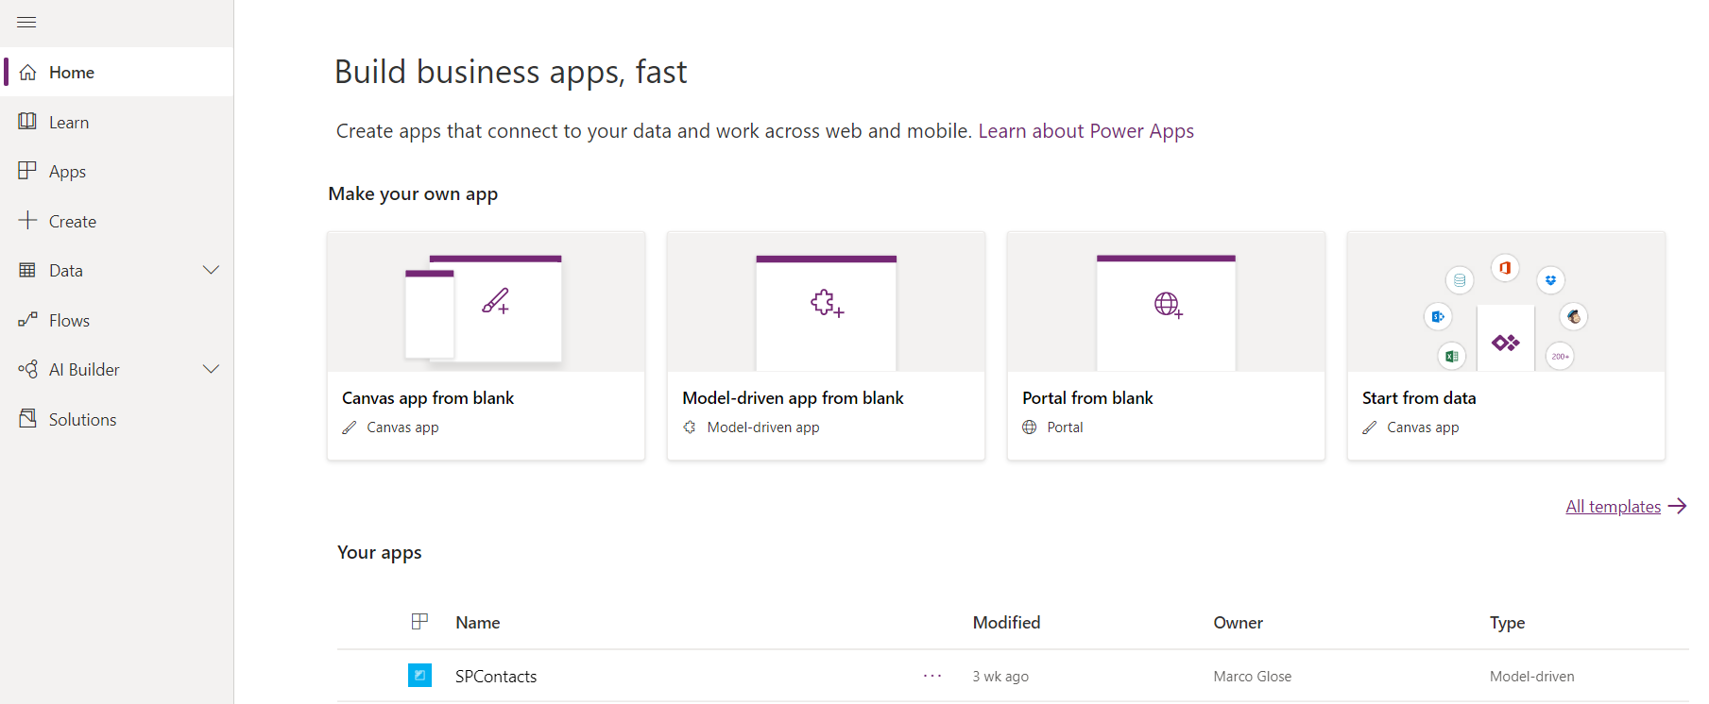
PowerApps
Get started with PowerApps Studio Intuitive Design interface

Slide 25
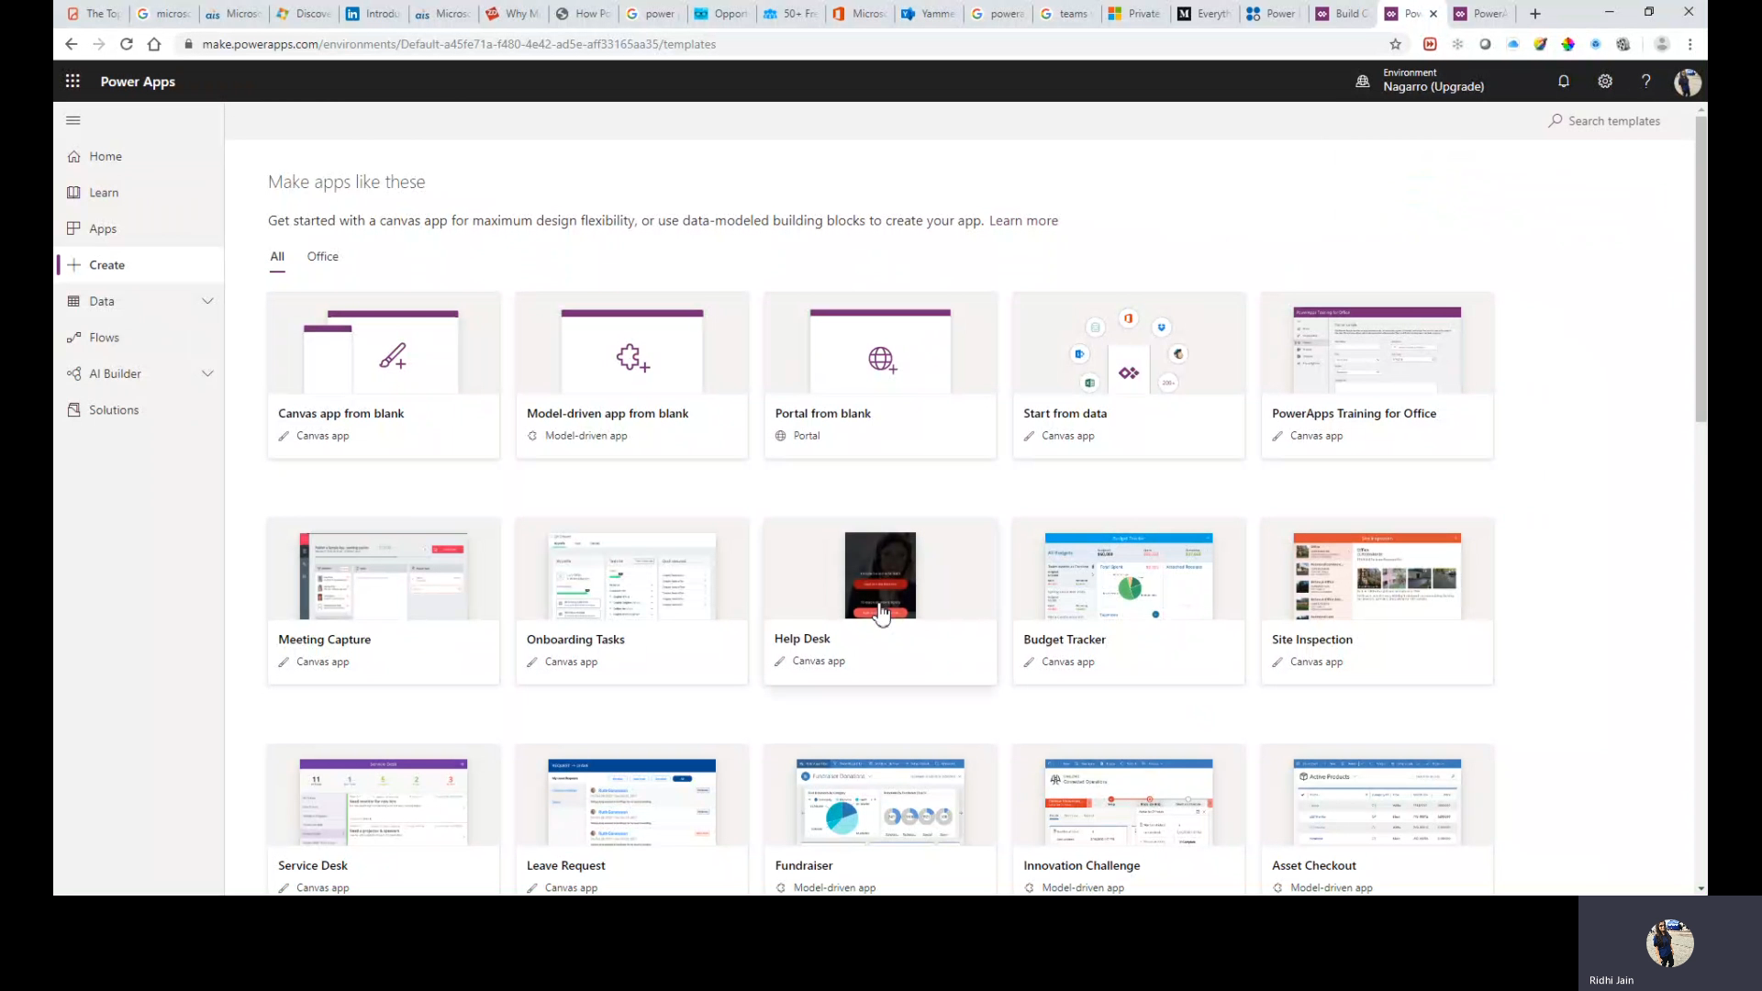
PowerApps
Choose from template/start from blank

Slide 26
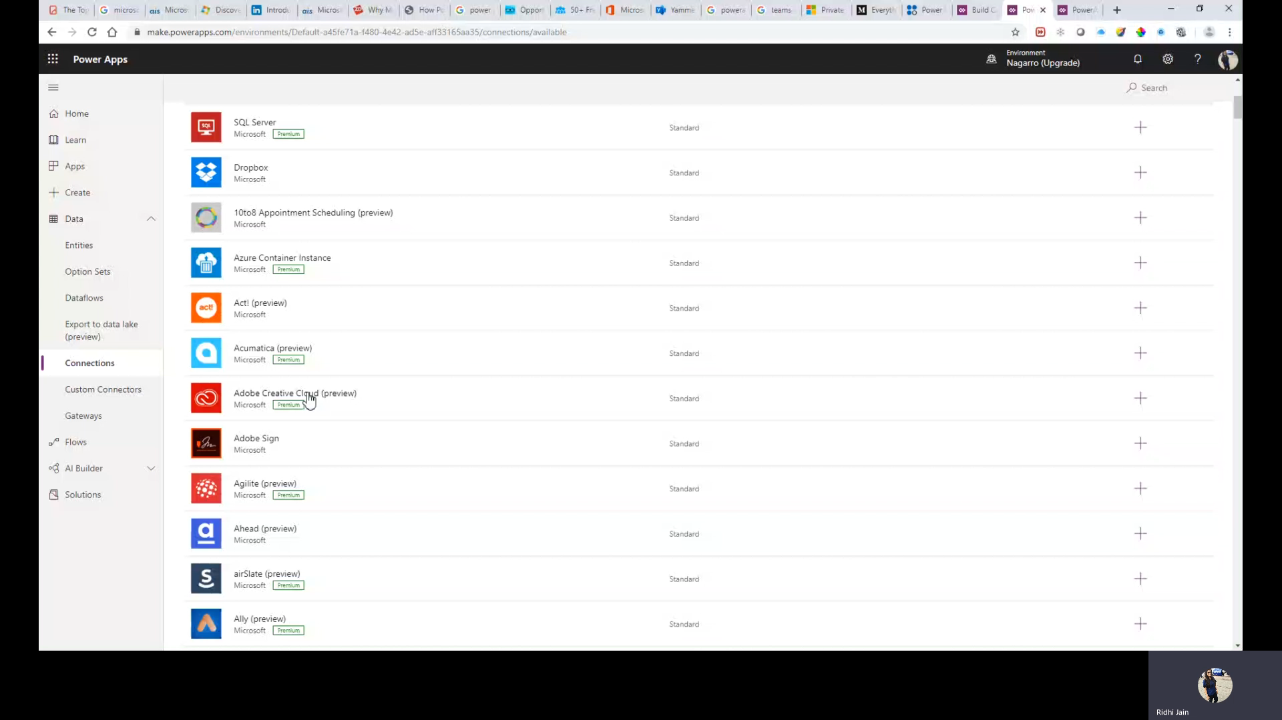
PowerApps
Integrate with your already existing data
Get started with PowerSpps Studio Intuitive Design interface

Slide 27
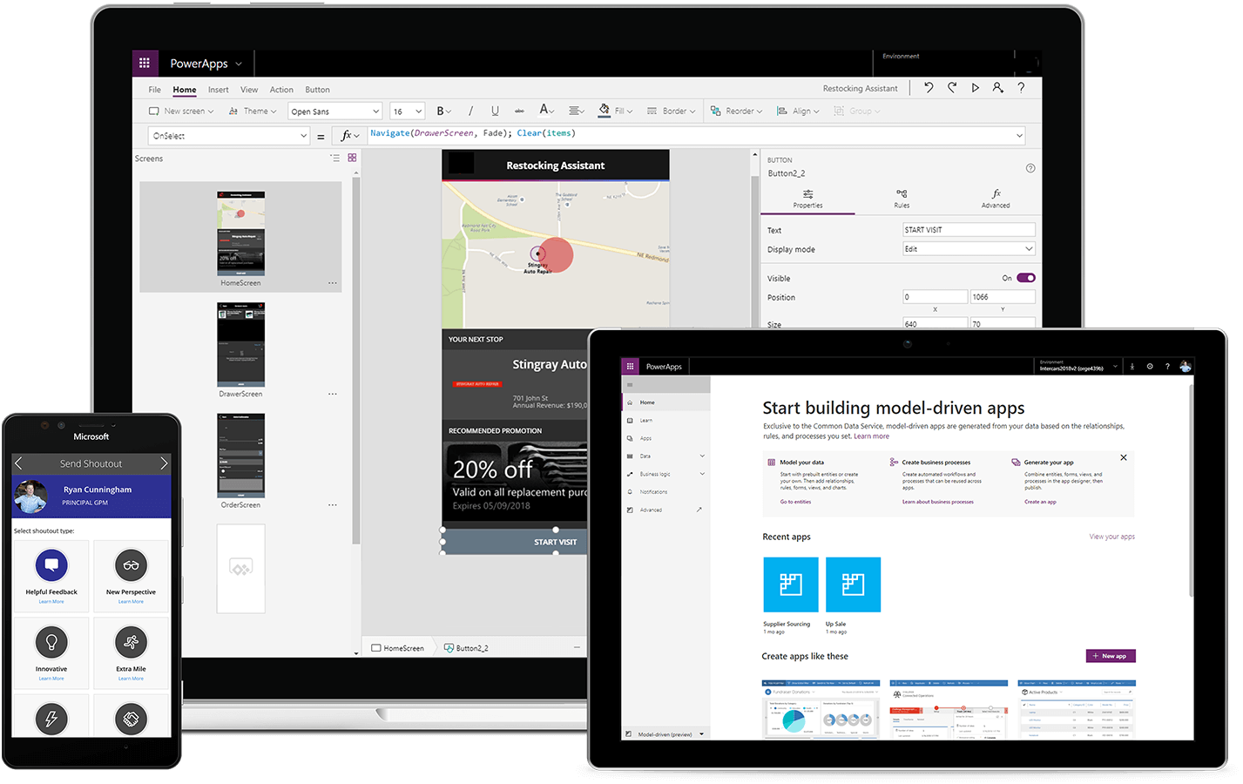
PowerApps
Build Apps for web and Mobile
Notes:
Canvas Apps help business-power-users to create and use custom business apps across platforms using Excel and PowerPoint skills
PowerApps Model-driven apps provides a metadata-driven architecture for creating and customizing apps without writing code

Slide 28
Power Apps Portal
Power Apps makers can now create a powerful new type of experience: web portals that surface data stored in Common Data Service to employees or users outside their organizations.
Notes:
Drag and drop features enables you to go deeper in your data
Explore in new way by asking simple questions. No need to learn any language
Easily clean, shape and model your data to create powerful and shareable reports

Slide 29
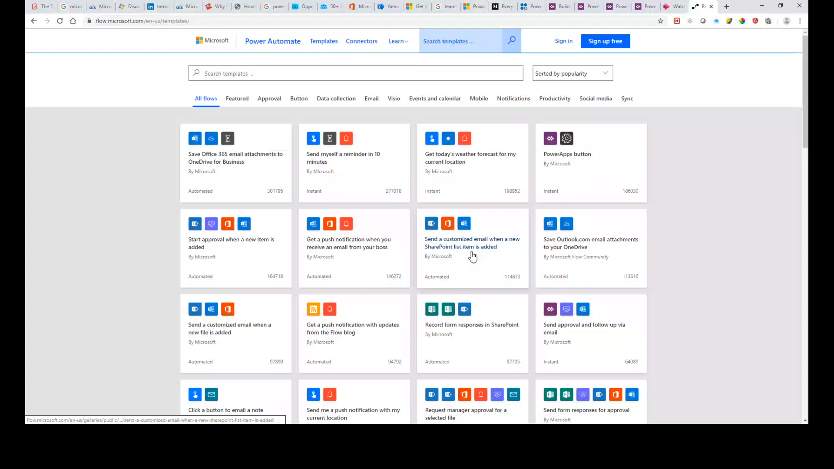
Power Automate
Choose from templates or start from blank

Slide 30
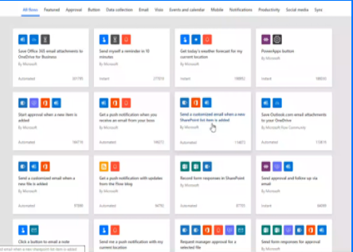
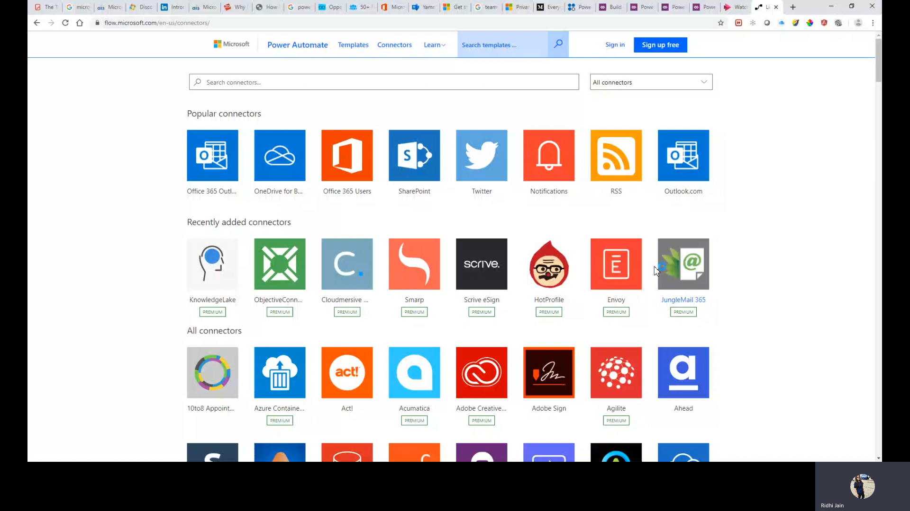
Power Automate
Connects to 100s of Apps & Services

Slide 31

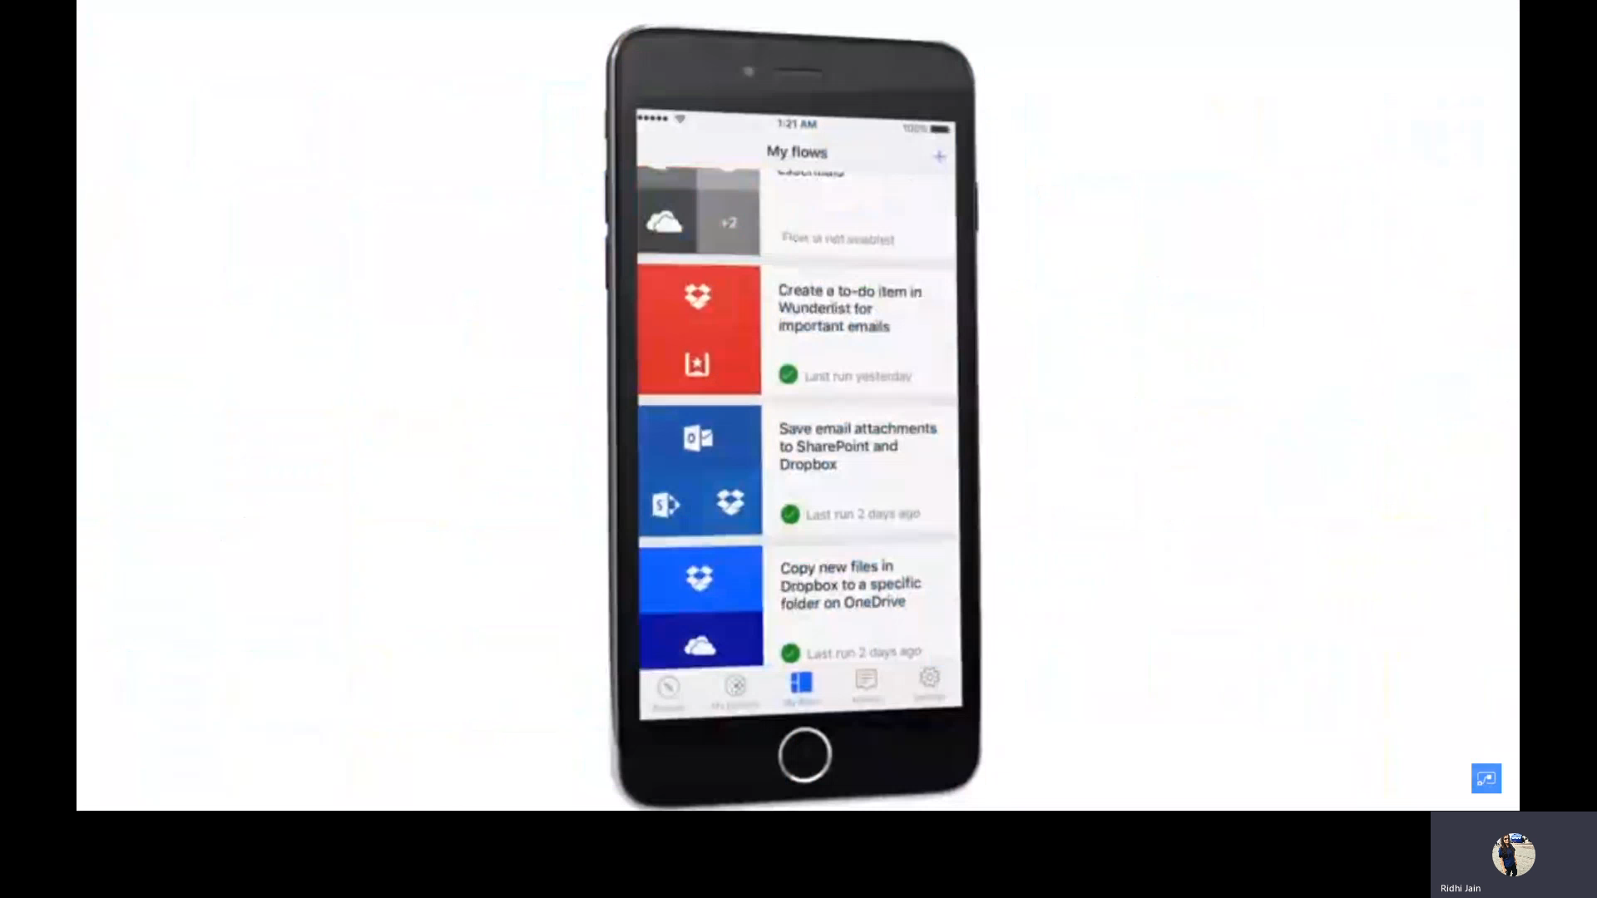
Power Automate
Automate tasks from anywhere using no-code approach

Slide 32
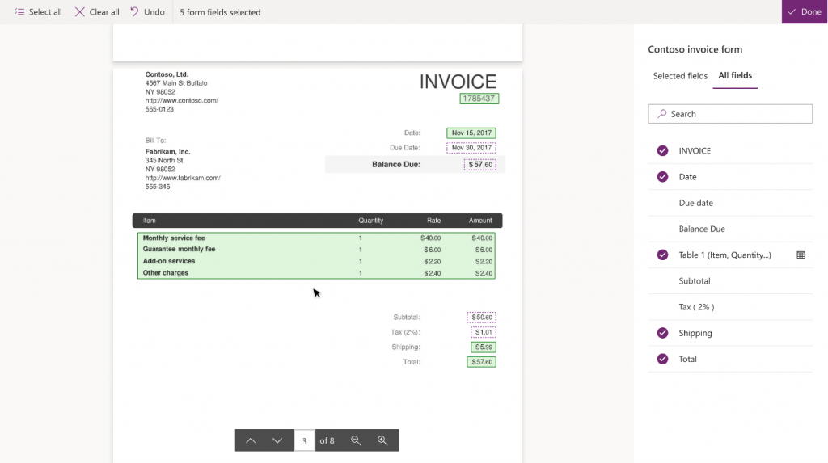
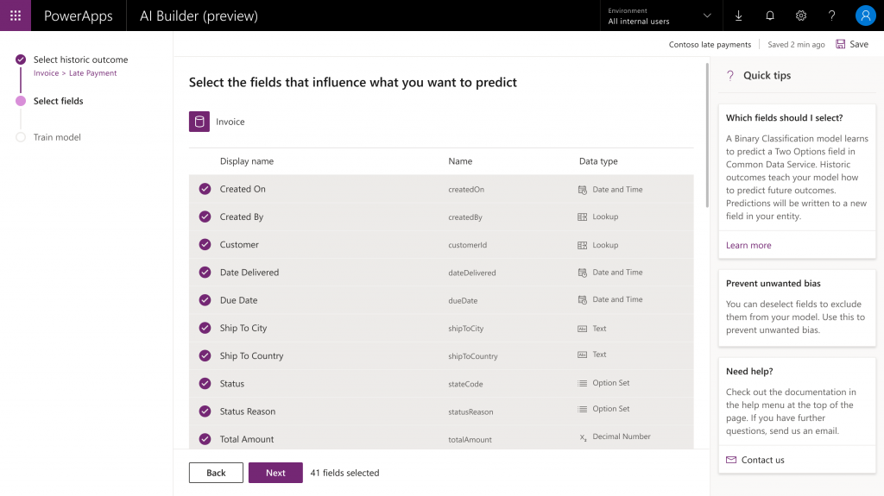
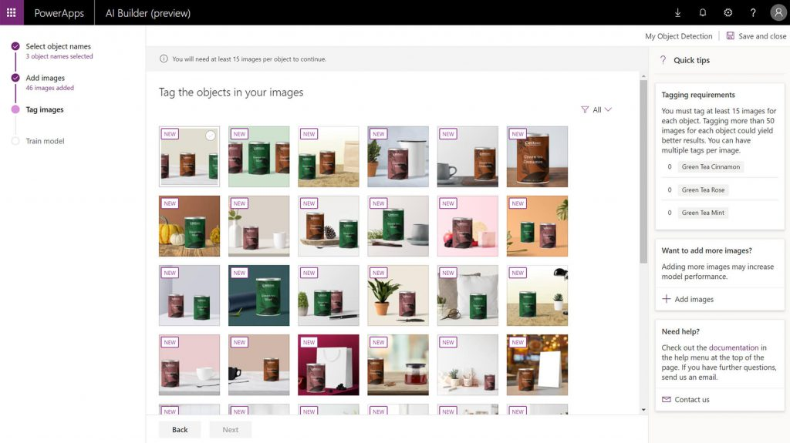
AI Builder
Object Detection
Lets you count, locate, and identify selected objects within any image
Binary Classification
Form Processing
An AI model that predicts yes/no business outcomes by learning to associate historical data patterns with historical outcomes
Identifies the structure of your documents based on examples you provide to extract text from any matching form
Notes:
AI Builder, our low code artificial intelligence platform that supports the Power Platform. It will be available for consumption on data that already exists in the Common Data Service (CDS), the enterprise-grade datastore included in the Power Platform. AI Builder is the platform for providing a low-code user experience for every developer to create and customize their PowerApps and Flows.

Slide 33
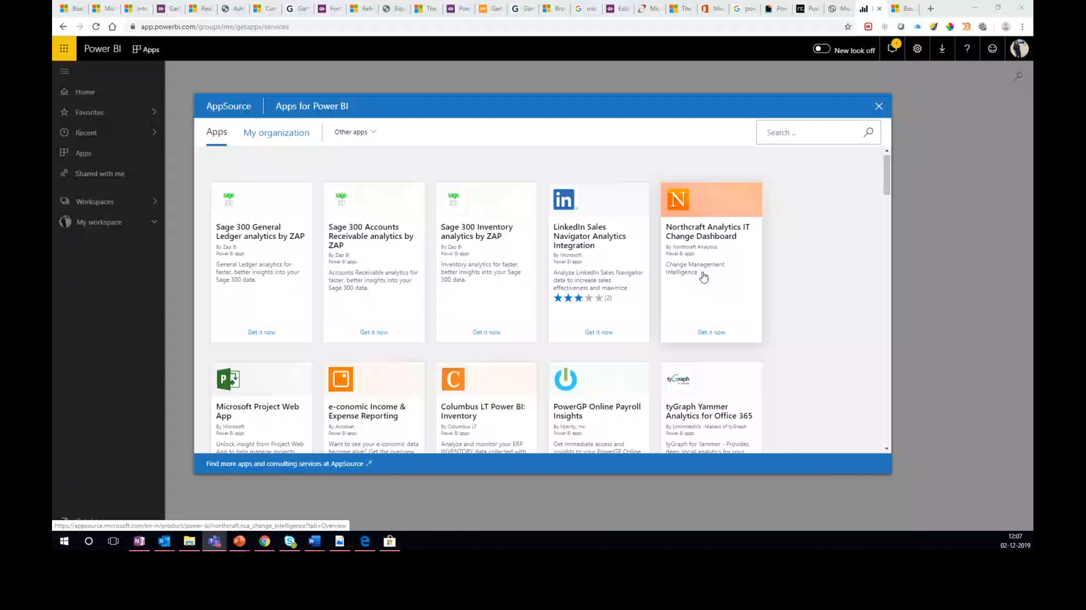
Power BI
See your data in a new way

Slide 34
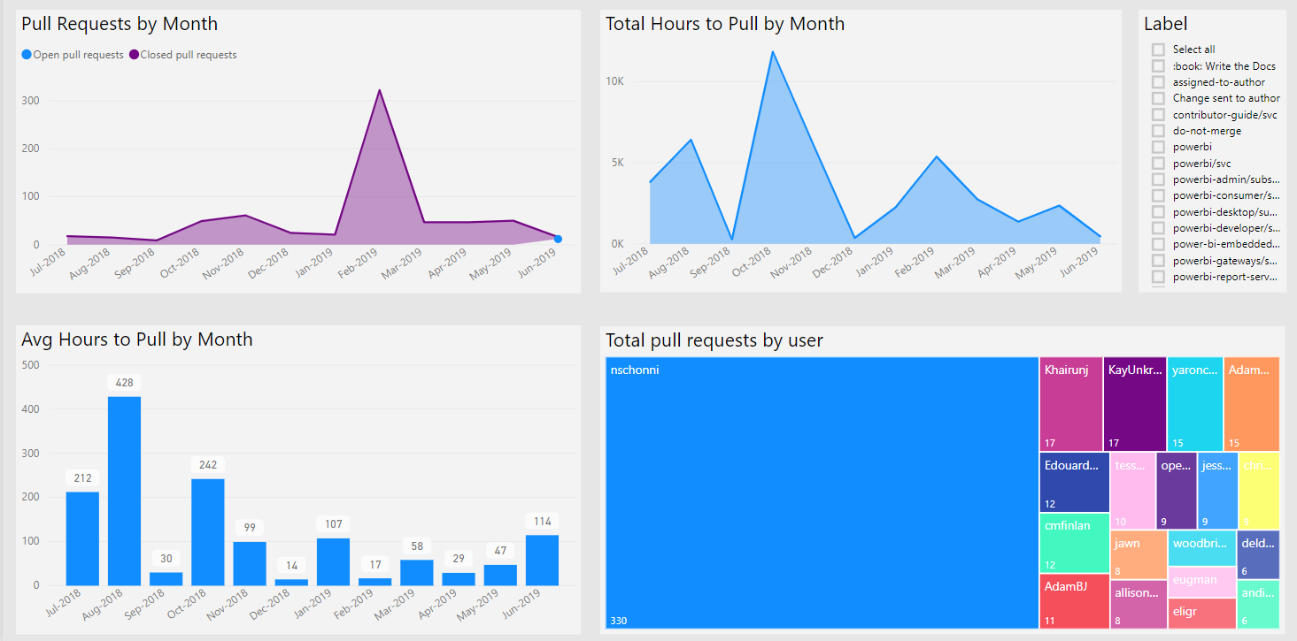
Power BI
Dashboard to witness live 360-degree view of business

Slide 35
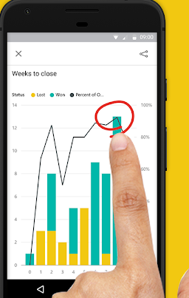
Power BI
Monitor data in real time from any device
Notes:
Drag and drop features enables you to go deeper in your data
Explore in new way by asking simple questions. No need to learn any language
Easily clean, shape and model your data to create powerful and shareable reports

Slide 36
Power Virtual Agents
Build chatbots with no code
Easily create and maintain intelligent chatbots without having to code. Microsoft Power Virtual Agents enables you to engage conversationally with your customers and employees.
Notes:
Drag and drop features enables you to go deeper in your data
Explore in new way by asking simple questions. No need to learn any language
Easily clean, shape and model your data to create powerful and shareable reports

Slide 37
Digital transformation stories from Power Platform customers

Slide 38













Microsoft’s Customer Stories
Credits : Microsoft

Slide 39


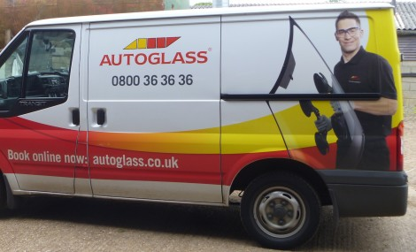

Business Requirement
Automated store audit and merchandising process
On-the-go services
Simple digital experience for field workers
Reduce paper based manual work
Solution
Used Power Apps, Power BI and Power Automate
Created merchandise app for store tracking using PowerApps and reporting dashboards using Power BI
Future Proof Platform
Built 8 applications ranging from time trackers and driver notifications to sales operation
Business Requirement
Improve customer travel experience
Increase employee engagement
Compliance
Solution
Developed app for Clubhouse Spa team
Spa records are logged in Dynamics 365, Power automate collects and deliver data and PowerApps is used for asking questions
PowerApps and Power Automate for reviewing audit ques and sending daily finding to compliance manager
Future Proof Platform
Working on other apps related to remote worker, service to VIP guests & comparing cargo shipping
Business Requirement
Boost productivity
Improve error prone, poor experience and inefficient internal processes
Eliminate paper-based processes and digitize
Solution
Moved from paper based to digitalized apps and all the 40 apps are developed in-house by one employee with no programming skills
Used Power Apps with CDS, Power BI, and Power Automate
Future Proof Platform
Developed apps across business, from HR to field service like fleet check, technical helpdesk app
Notes:
G&J Pepsi IT team used PowerApps to create Store Audit, an app that enables better mobility and flexibility for field personnel. Previously, they’d record key information from a store audit on a piece of paper, then place it in a tray with little accountability and often no resolution. Now those in the field can inspect stores, collect data, provide an aggregated view to leadership, and better ensure customer satisfaction.
Similarly, they created a merchandiser app for better store tracking. If, for example, delivery personnel see displays that need to be fixed, they now know that submitting this information will trigger alerts to the supervisor and upwards. Previously, their only course of action was to email the salesperson, with no assurance the salesperson would be available to respond. “That email could just go in a black hole,” summarizes McKinney.
Virgin Atlantic
Virgin Atlantic developed an app for its Clubhouse Spa team that helps employees track passengers’ histories and ensure that they’ve filled out the necessary health questionnaires. The app makes full use of the airline’s connected Microsoft solutions—spa treatments are logged into the passenger’s record in Dynamics 365, Microsoft Flow collects and delivers data from Dynamics 365, and PowerApps serves up the customer-facing piece of the health questionnaire.

Slide 40
Any Questions?

Slide 41
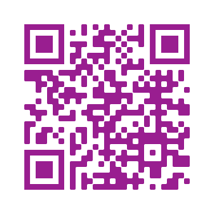
Please fill out the survey! & Win Swags!!
https://www.powerplatformbootcamp.com/survey

Slide 42
Thank You For Attending

